Slide 1
Health Insurance Marketplace
2017 Open Enrollment Highlights

Slide 2
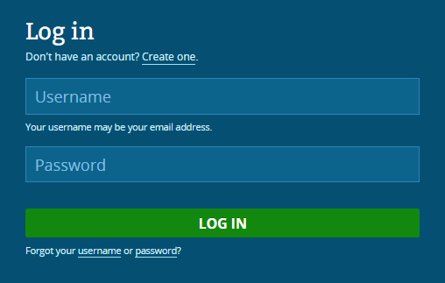
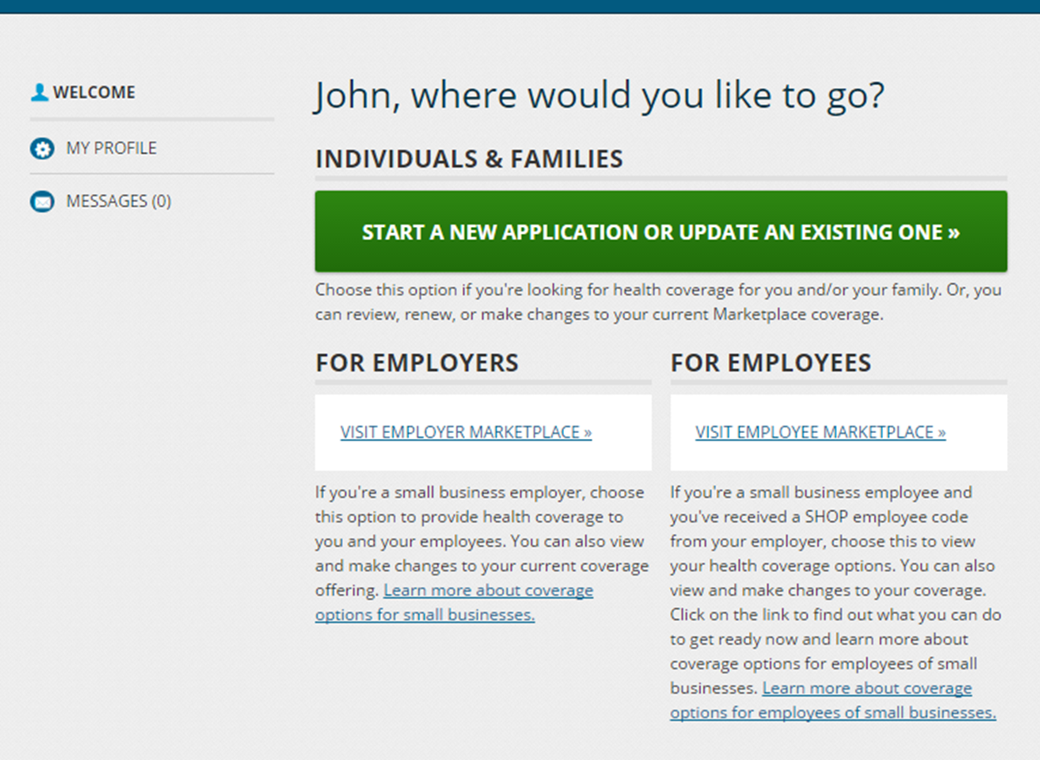
Getting Started
Before Open Enrollment:
Consumers receive Marketplace Open Enrollment Notices (MOEN) and letters from their current insurance plan by the start of Open Enrollment.
Marketplace Open Enrollment Notices include
OE Dates
Risk of losing APTC, Likely still APTC eligible, Open data matching issue
Issuer Notices include
Availability of plan, Cost & benefit changes, Discontinuation notices
Online, when OE begins:
Creating accounts, logging in, identity proofing, and starting or updating applications is consistent this year from last year’s open enrollment.
When consumers log in, they’ll select “Start a new application or update an existing one”
Content is tailored for new consumers and re-enrolling consumers throughout the application and enrollment flow
Log In
Guiding Page
Application
(pre-filled)
Eligibility Results
Enroll To Do List
Plan Results
Enrollment Confirmation
Post Enrollment

Slide 3
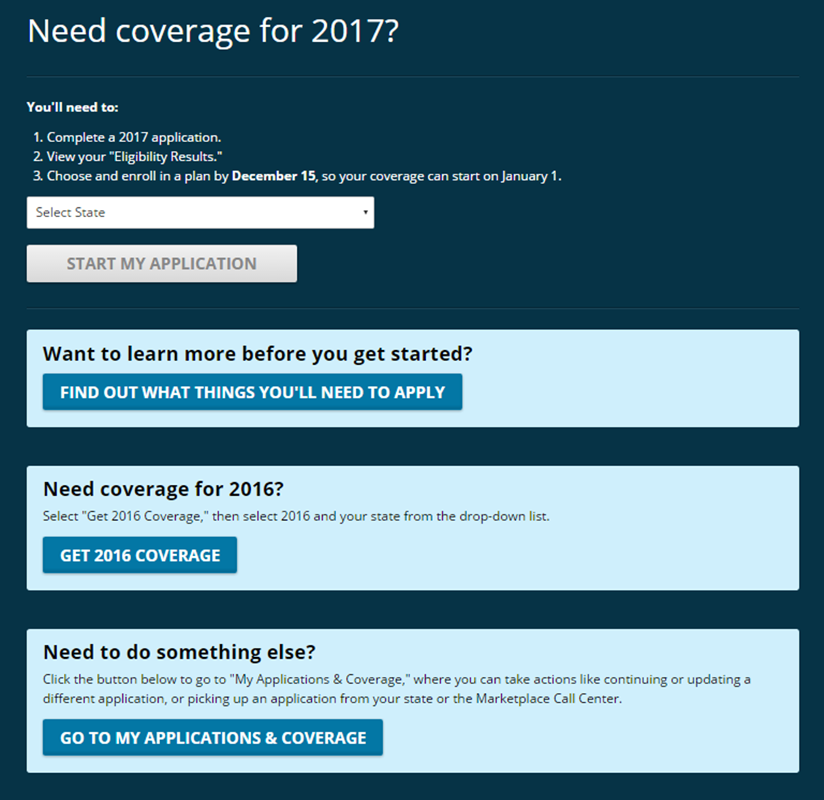
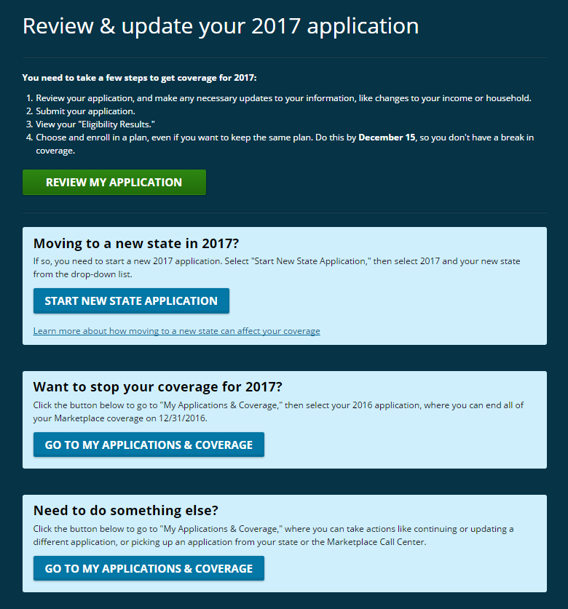
Starting or Updating Your Application
New Consumer
Re-enrolling Consumer

Slide 4
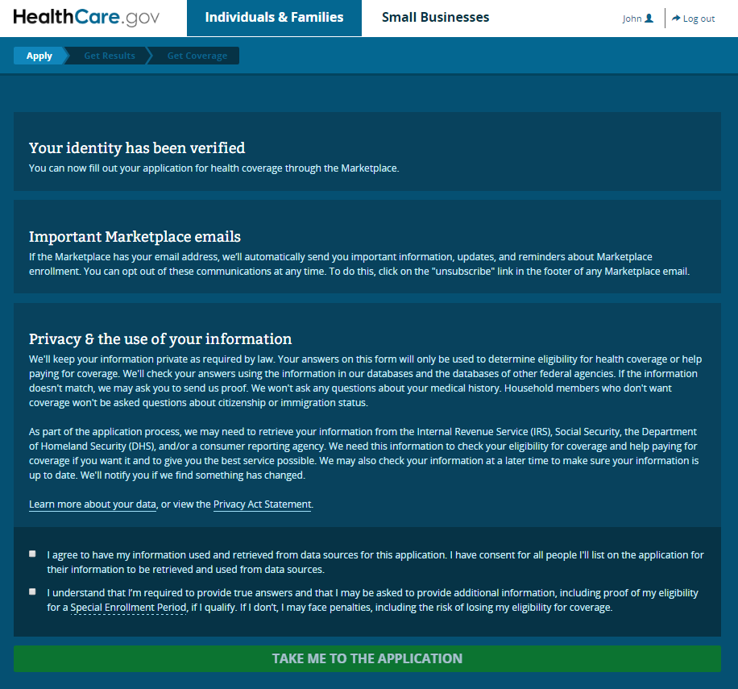
Application
New consumers will be prompted to identity proof before starting their application. Re-enrollees will go straight to the start of the application including the privacy policy before seeing application questions.
Applications will be pre-populated for re-enrollees with the information from the last version of their 2016 application.
When assisting consumers with the application, don’t forget to answer the questions about if someone is helping you apply/enroll so you can add your information.

Slide 5
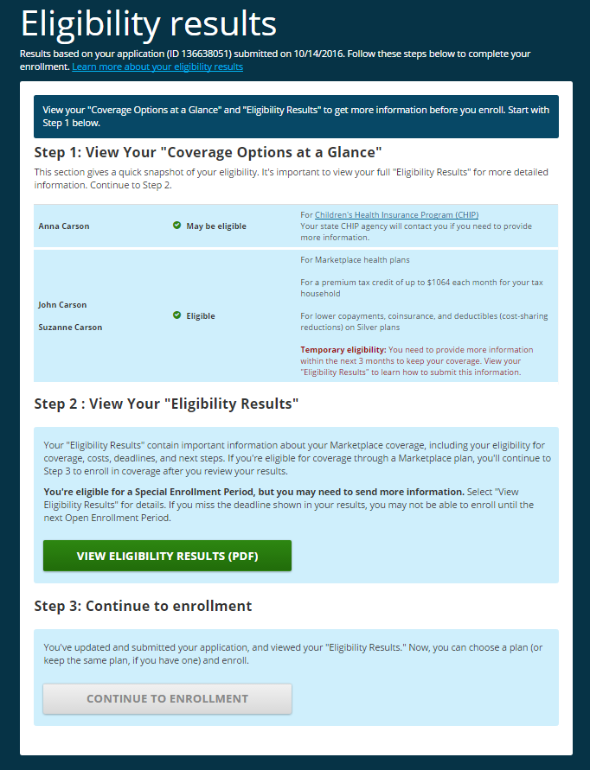
Eligibility Results
Eligibility results displayed on the page
Consumers will see an overview of their results on screen before moving forward
Separating Calls to Action to help consumers understand their next steps
Review summary results (positive eligibility & important flags)
View detailed PDF notice
Continuing to Enrollment (dynamic if QHP eligible)
Highlights summary-level eligibility for tax credits, cost sharing reduction silver plans, Medicaid & CHIP
Consumers are grouped with shared eligibility
Calling out existence of a data matching issue & that results are temporary (displays in red)
Dynamic information in step two around SEPs, mixed household eligibility, and Medicaid/CHIP enrollment next steps.
Notice includes updates to streamline content and fact sheets

Slide 6
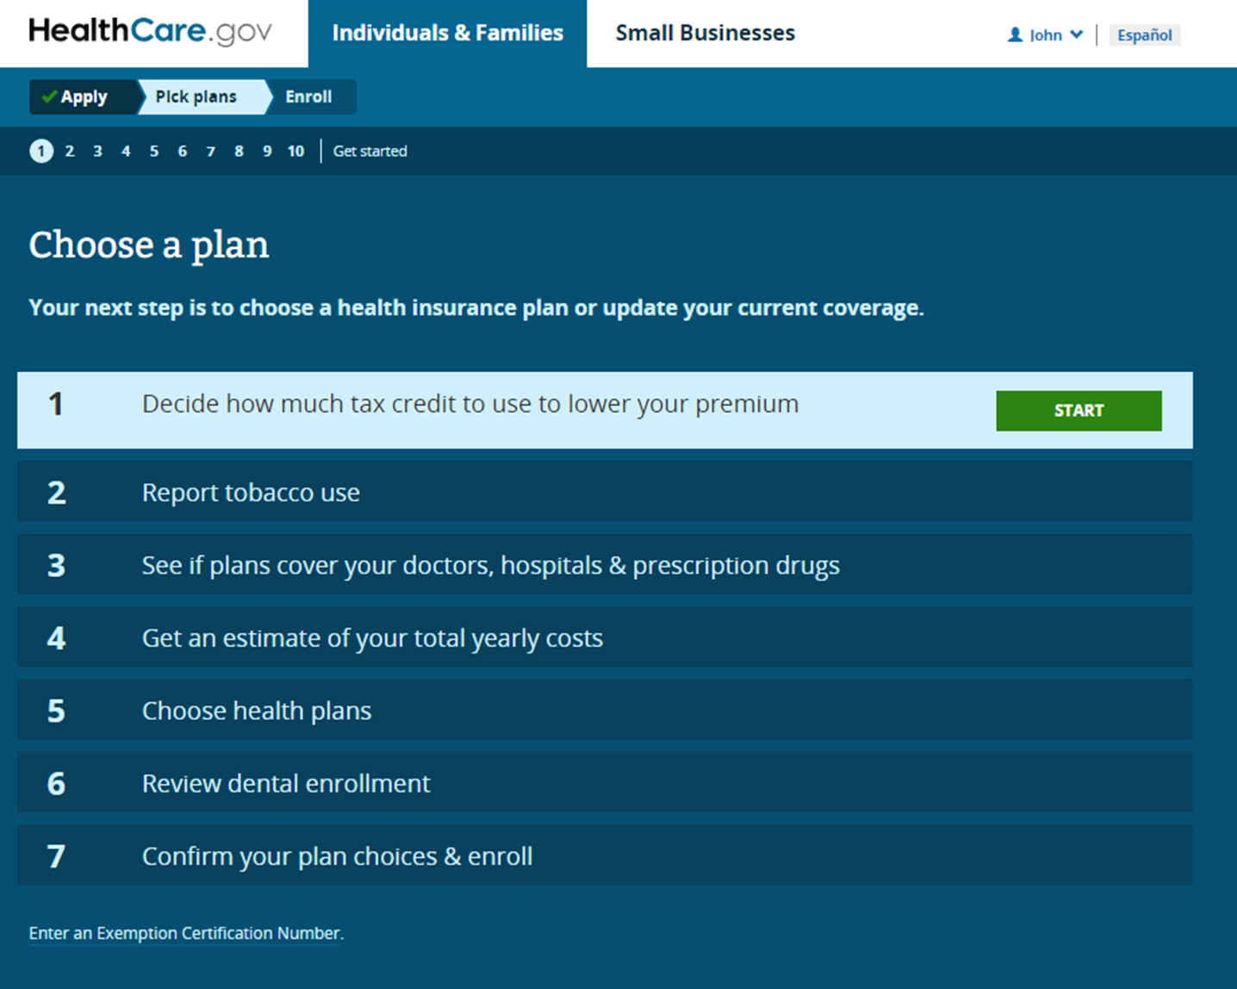
Start Shopping
Overall Consumer Improvement Highlights
The new plan compare is a revamp of the enrollment experience for consumers, which introduces a completely new user interface (UI) based on extensive consumer testing and feedback. The updated experience includes the following benefits and features:
Completely mobile optimized
Simplified how to choose the amount of APTC to use
Integrated decision support features to see whether doctors, drugs, and facilities are covered, including the ability to filter plans on specific ones
Continuous progression through the enrollment steps through improved navigational experience
Streamlined on screen content with improved integrated help for each step including definitions and hover tool tips

Slide 7
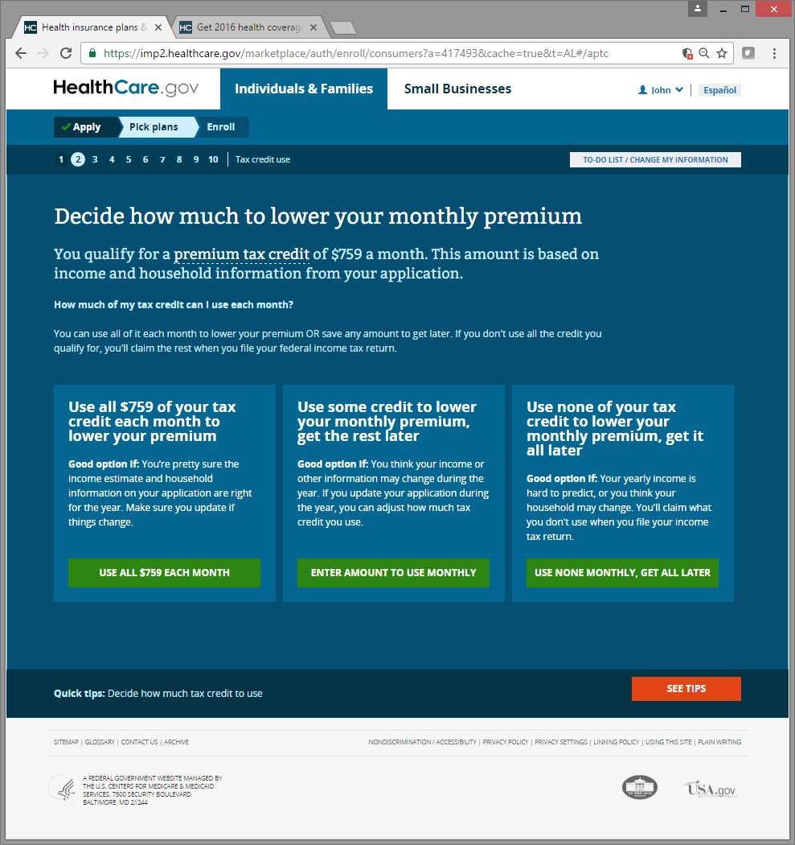
Choosing How Much Advanced Premium Tax Credits to Use
Streamlined educational and decision making information around APTC from 3 screens with lengthy, repetitive and confusing content down to one interactive step around using their tax credit.

Slide 8
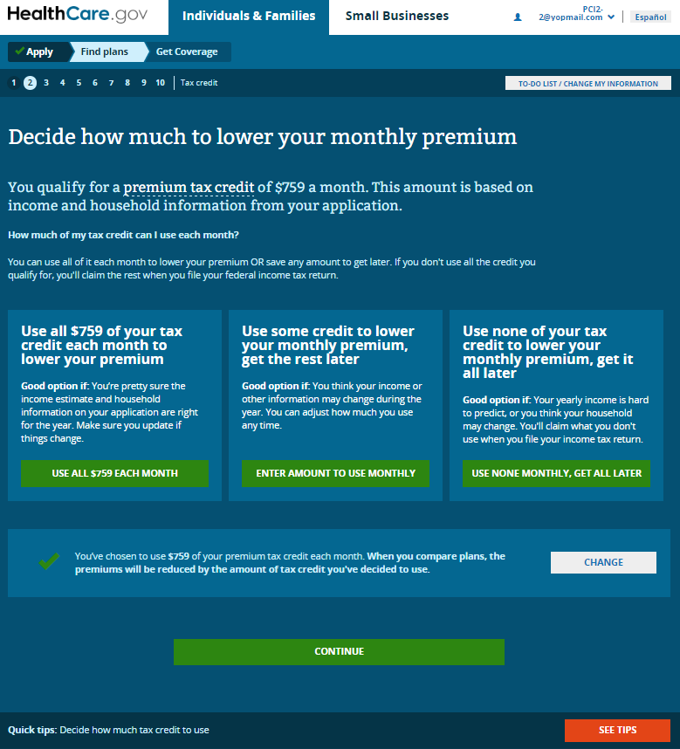
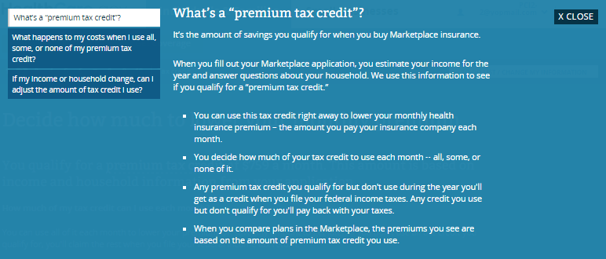
Tips & Tools
Continuous progression and knowing where you are in the process
Ability to quickly go back to a particular step and edit / change information and preferences
See Tips – rolls up a new help feature to provide more content and information about this particular step. Helps consumers dig deeper if they need assistance with anything on each page (content is in context of the step they’re on)

Slide 9
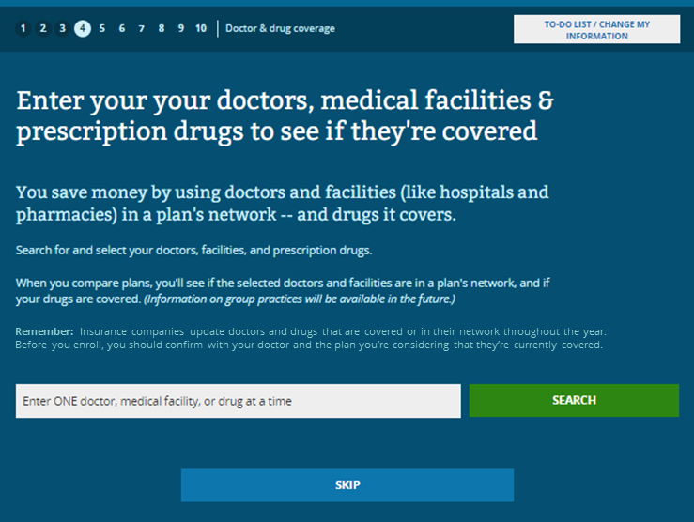
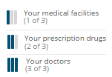
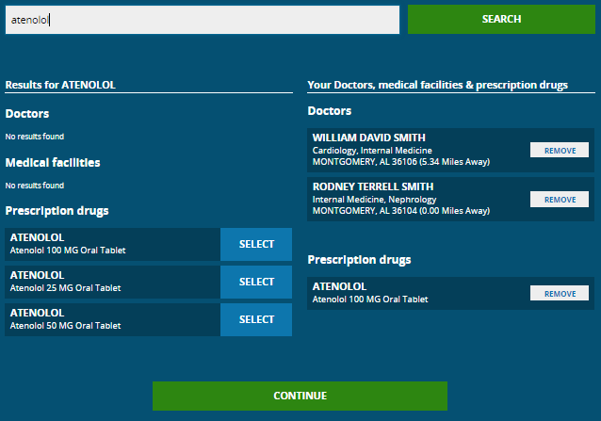
See Which Doctors, Drugs & Medical Facilities are Covered
Integrated Doctor/Drug/Facility and the ability to see an estimate of total yearly costs based on anticipated usage. While we introduced these features last year, they weren’t provided to consumers as part and parcel to their decision making process or before they saw plans.
This year, we’re helping consumers up front who have specific doctor and drug needs add their doctors and drugs, two of the top things consumers always say are important to them when choosing a plan, so that when they see their plan results, which doctors and drugs are covered by each plan are already visible as they review their options. In addition, consumers will now be able to filter plans based on specific doctors, drugs and facilities in combination with other things that are important to them (such as price, deductible, plan type, and more).
We’ve also worked with issuers to update their data feeds with doctors and group designations so that consumers can now find individual doctors or simply search for a group practice, depending on their preference
In plan results on each plan:

Slide 10
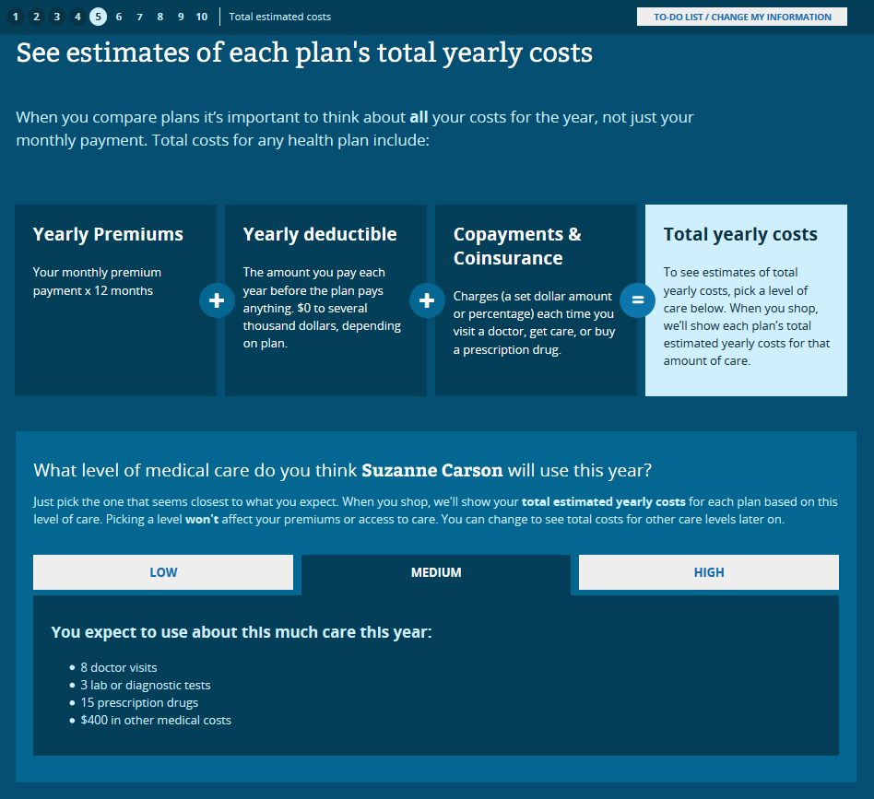
Estimated Yearly Costs (out of pocket costs)
See estimates of yearly costs:
Consumers have the option to select an estimated level of health care utilization of Low, Medium or High for each person to see an estimate for what total out of pocket costs maybe when viewing and comparing plans

Slide 11
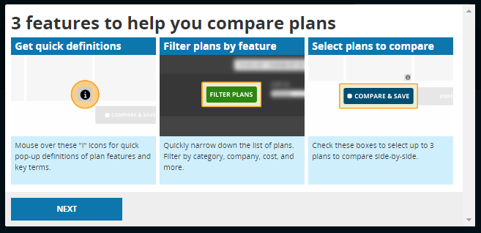
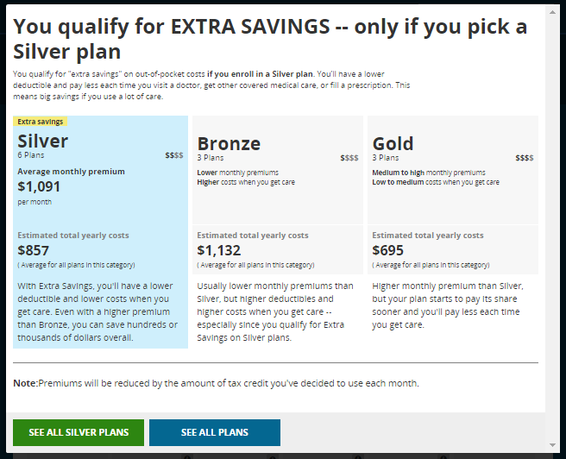
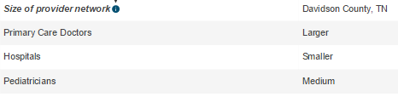
Features in Plan Results
Plan Results
New quick tips to highlight features (tips to learn more about an item, filter feature, and how to compare & save plans)
Consumers with Silver cost sharing reduction (CSR) see special messaging reminding them that they get extra savings if they pick Silver plans.
Option to pre-filter results just to Silver plans or See All Plans
If consumers with Silver CSR select a non-Silver plan, a warning message appears and offers the option to go back and select Silver
Pilots:
Quality ratings displayed on results cards in pilot states. Three sub measures displayed on plan details.
Size of provider network (network breadth) displayed in pilot states on plan details pages under access to doctors and hospitals

Slide 12
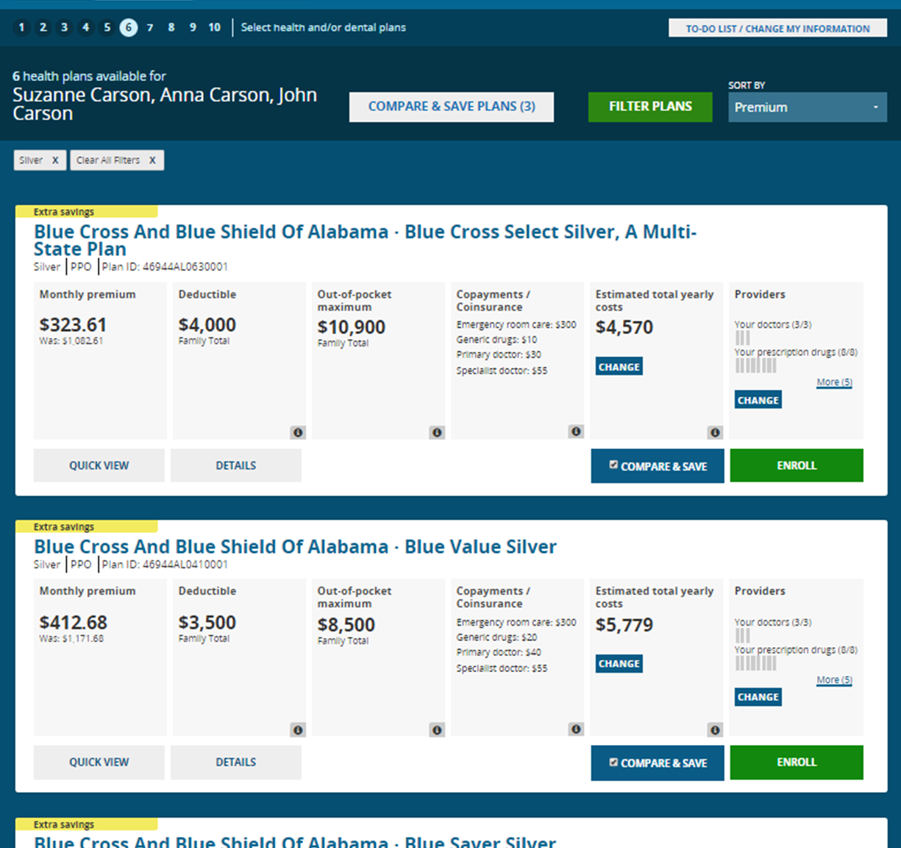
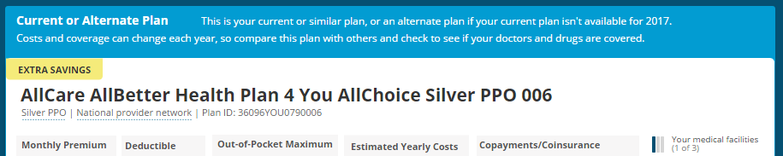
Viewing & Comparing Plans
Plan Results
Simplified card information to the most important top things consumers are looking for in a snapshot
Applied filters easily displayed and removable across the top
Quick View shows expanded plan information in a modal pop up including which specific docs & drugs are covered by that plan
Compare & Save plans enables consumers to select plans to compare side by side and save them for later
“Extra savings” labels to help CSR eligible consumers see these plans in results
Ability to sort by premiums, deductibles or estimated yearly costs
Details shows a full page plan information for all benefits and coverage levels
Re-enrollees will see their plan highlighted at the top of their results, if available

Slide 13
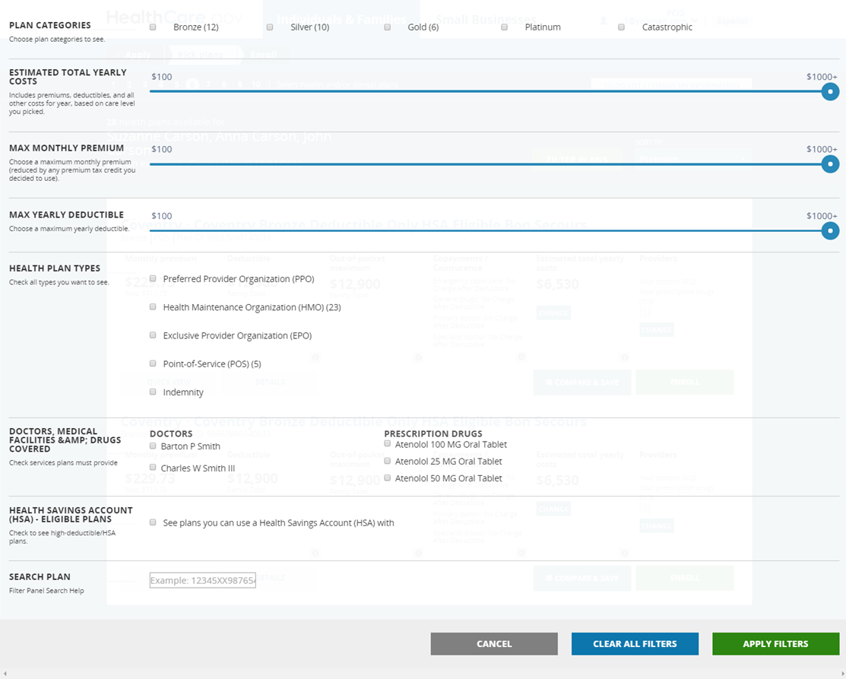
Filtering Plans
Filters help narrow plans based on:
Category (Bronze, Silver, Gold, Platinum)
Estimated yearly costs, premium, and deductibles (range sliders)
Health plan type (HMO, PPO, etc.)
Specific doctors, drugs, and facilities if added

Slide 14
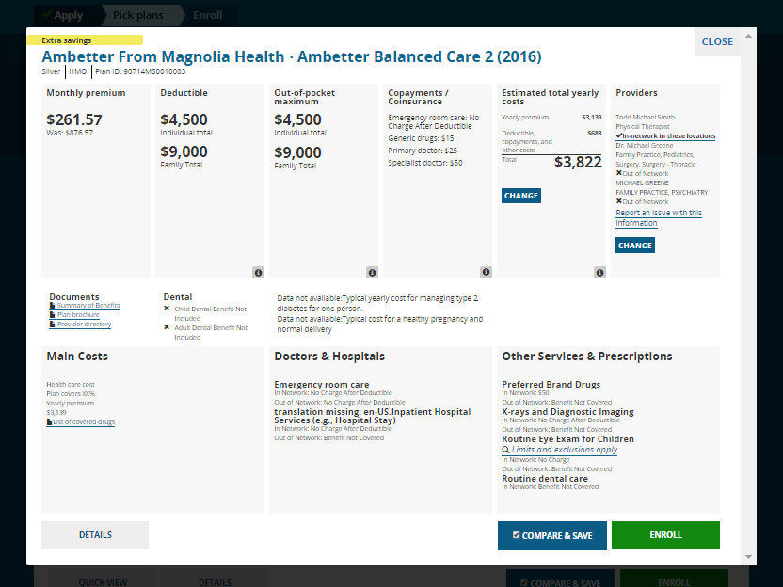
Quick View
Shows expanded cost and benefit information including specifically which doctors and drugs are covered by the plan

Slide 15
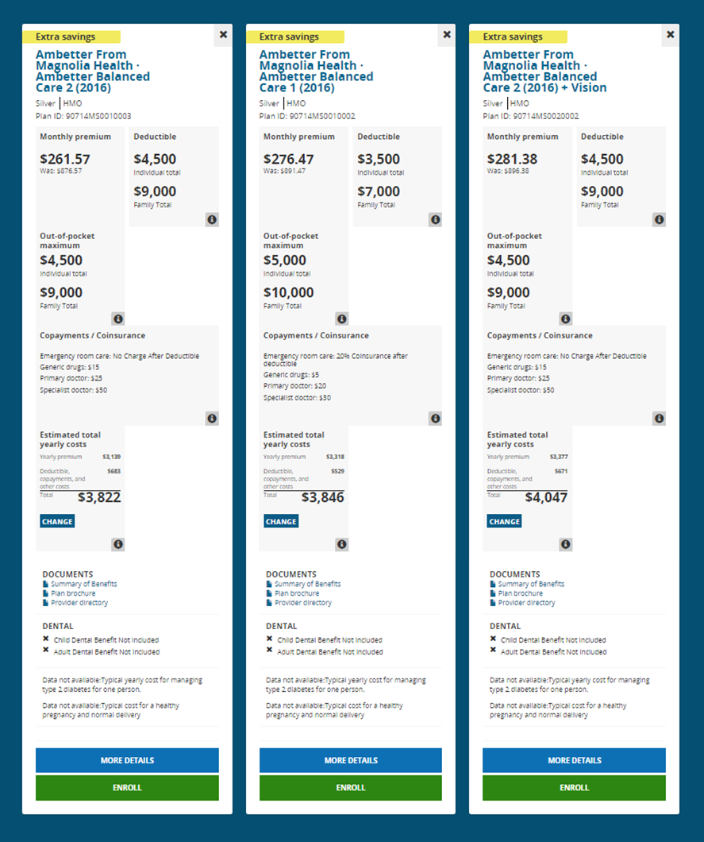
Comparing Plans
Select a few plans to view side by side
Consumers can choose a few plans and see them side by side to review their cost and coverage information
Comparing also saves the plan for later

Slide 16
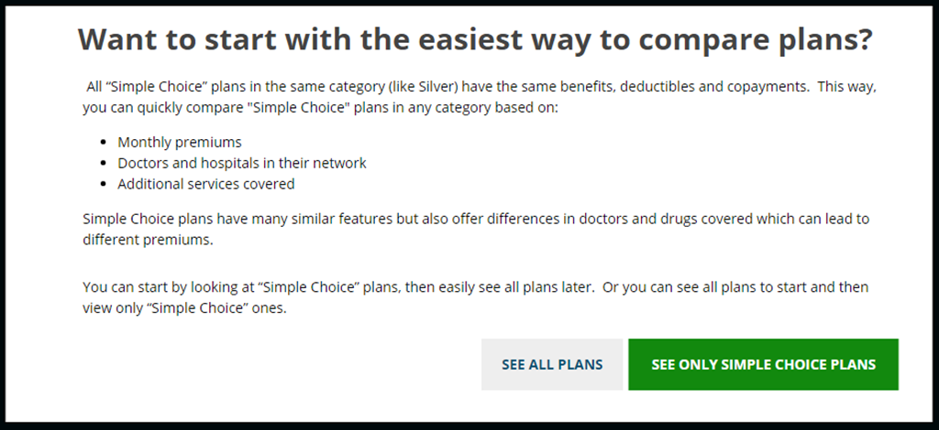
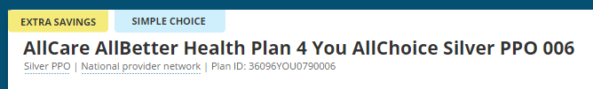
New Simple Choice Plans Available for 2017
Simple Choice is a new plan option available. Consumers that are interested in looking at Simple Choice plans will have the option to pre-filter their plan results to just see those plans. Consumers that want to view all plans first and then perhaps narrow their options later will see a tag for Simple Choice plans within results to help them tell which plans these are and also can filter on Simple Choice plans on their own.

Slide 17
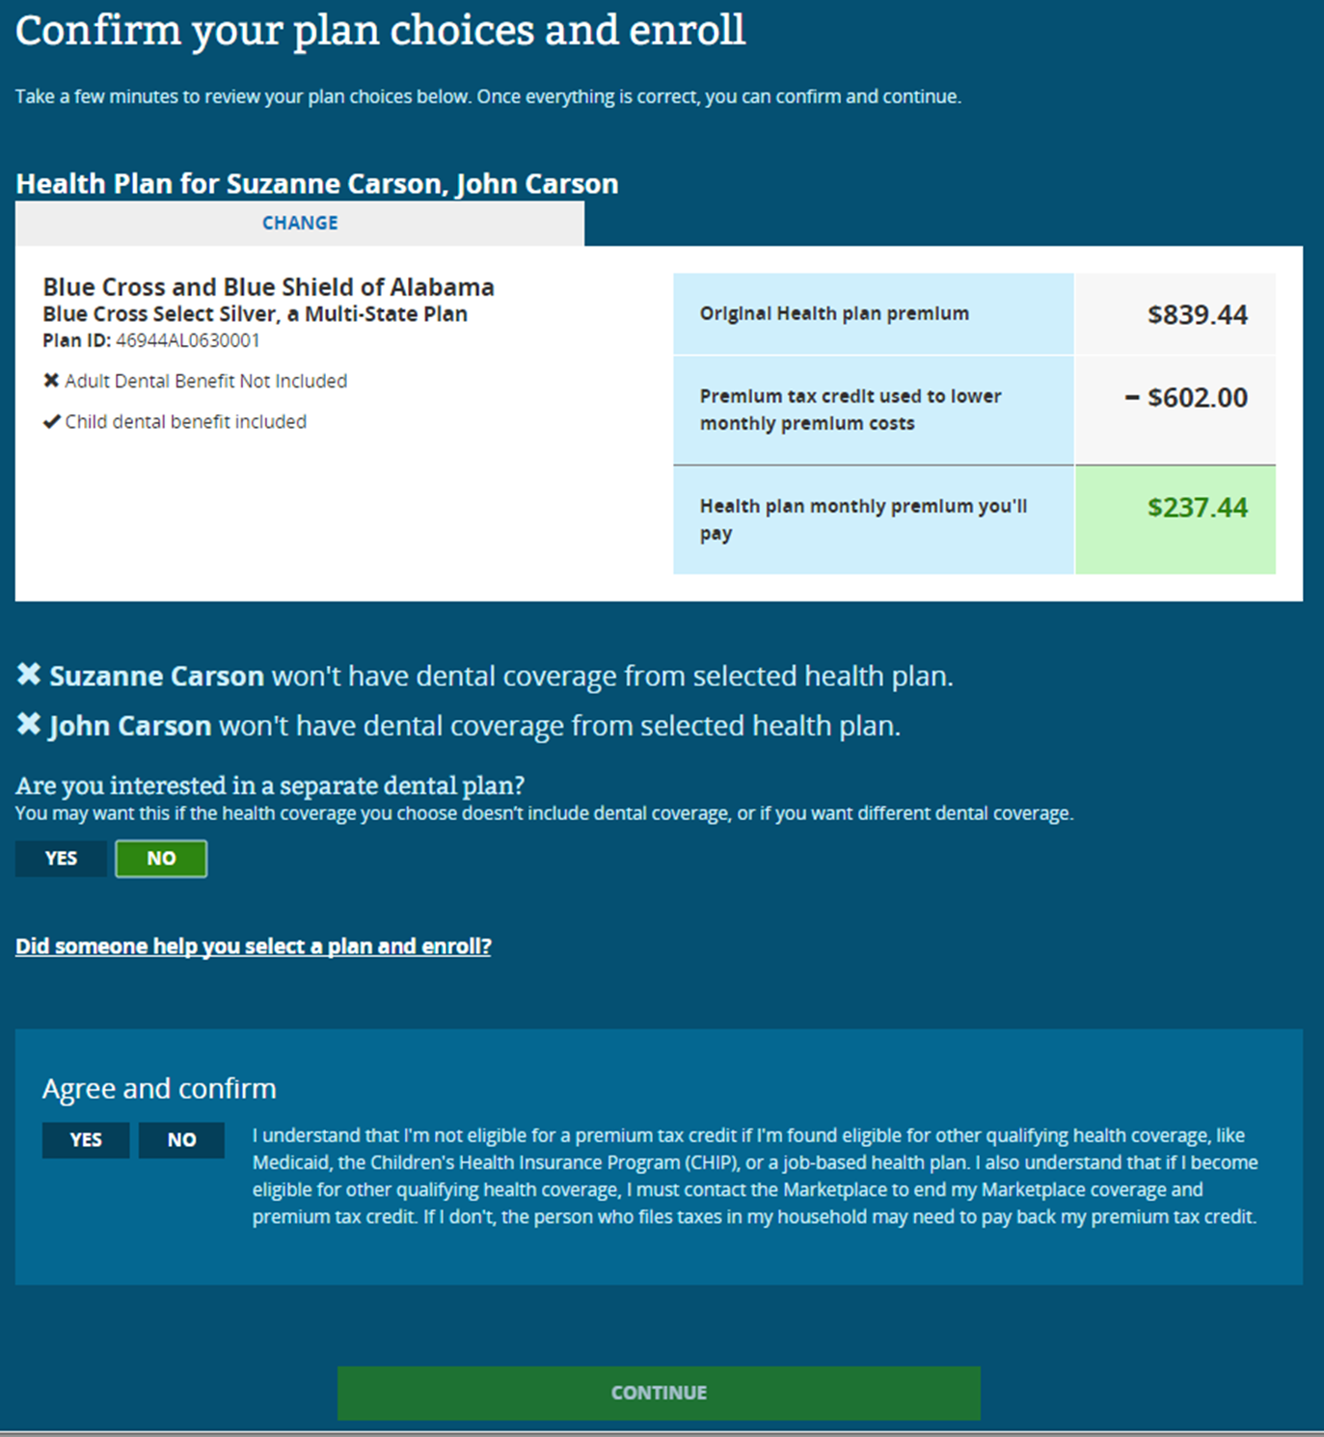
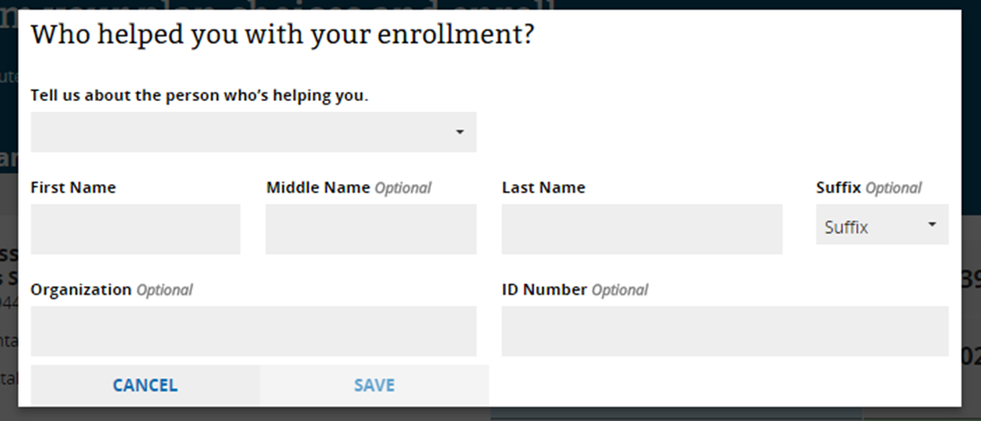
Confirm Your Plan Selection
Final plan review
After consumers choose all the health plans and dental plans for their household, they’ll see a final confirmation page with all plan selections listed to review and then submit their enrollment.
When helping consumers enroll, don’t forget to select the question about someone helping you select a plan and enroll in order to add or verify your information.

Slide 18
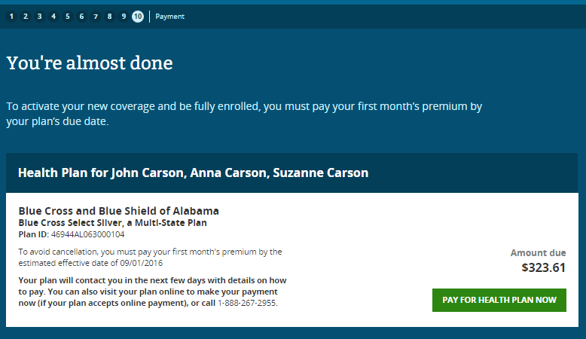
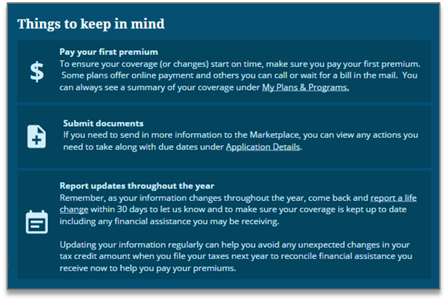
You’re Almost Done
Enrollment Confirmation & Transition
Confirmation: Once a consumer has confirmed all of their plan choices, we’ve updated the final page to help provide better context that there’s just one more final step left for the consumer to confirm their coverage – pay their first premium.
Continue to offer payment redirects to those plans with websites that accept online payment options and still provide consumers with customer service information so that they can contact their insurance company and arrange other ways to pay their premiums.
Reminders after enrolling: new important reminders page after consumers finish enrolling to help consumers find other parts of HC.gov and provide reminders to take action:
Pay first premium
Submit documents
Report life changes later in the year

